Slide 1
Data Driven Methods: Texture Synthesis
CMPUT 206
Nilanjan Ray
Slide courtesy: Dr. Rob Fergus, Dr. Alyosha Efros

Slide 2
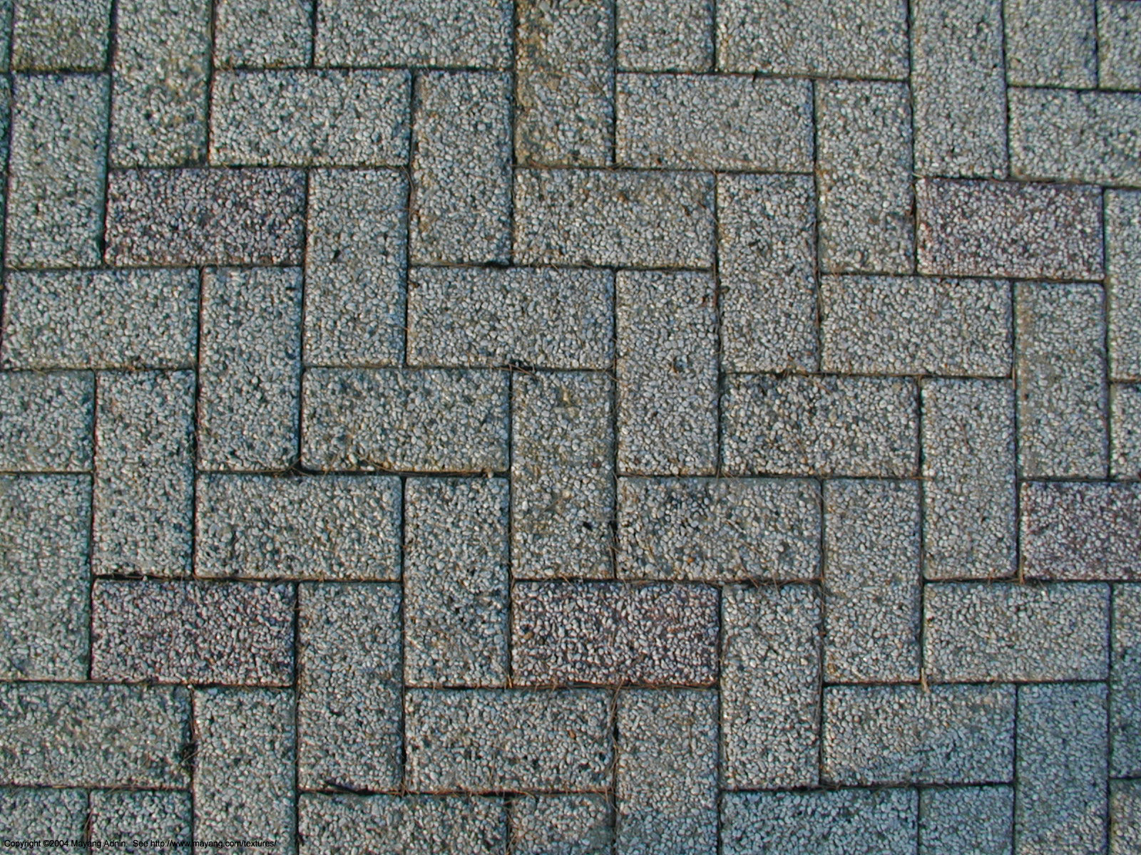
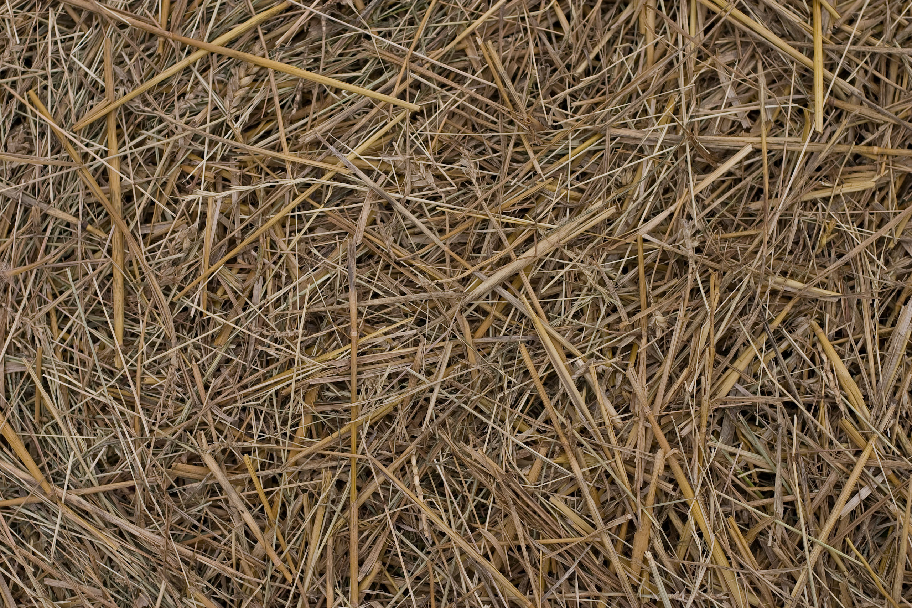
What is texture?
Repetitive patterns in images
Examples:

Slide 3
What is texture synthesis?
Create new samples of texture from given sample(s)
Example:

Slide 4
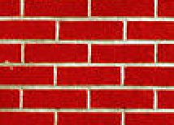

Data-driven texture synthesis
Find all the windows in the image that match the neighbourhood
consider only pixels in the neighbourhood that are already filled in
To synthesize p
pick one matching window at random
assign p to be the centre pixel of that window
Creates texture
one pixel at a time!!
p
input image
synthesized image

Slide 5
Some Details
Growing is in “onion skin” order
Within each “layer”, pixels with most neighbors are synthesized first
If no close match can be found, the pixel is not synthesized until the end
Using Gaussian-weighted SSD is very important
to make sure the new pixel agrees with its closest neighbors
Approximates reduction to a smaller neighborhood window if data is too sparse

Slide 6

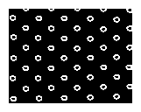
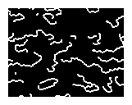
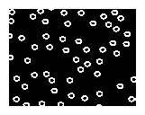
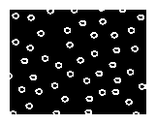
Neighborhood Window
input

Slide 7
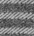
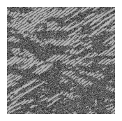
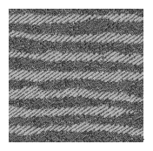
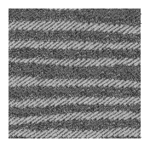
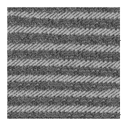
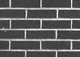
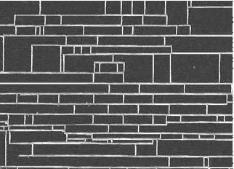
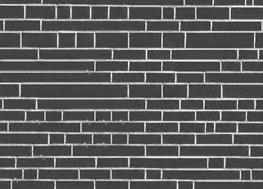
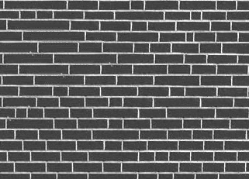
Varying Window Size
Increasing window size

Slide 8
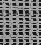
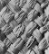
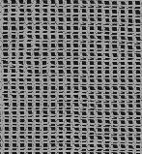
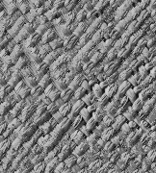
Synthesis Results
french canvas
rafia weave

Slide 9
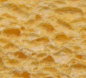
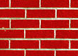
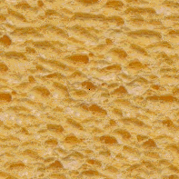
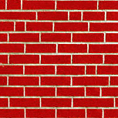
More Results
white bread
brick wall

Slide 10
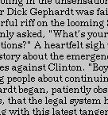
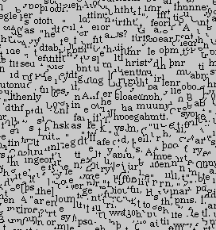
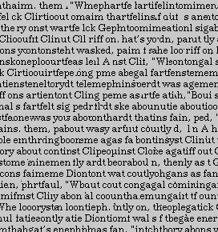
Homage to Shannon

Slide 11
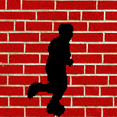
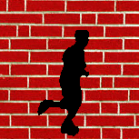
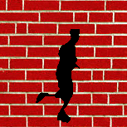
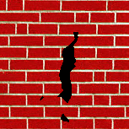
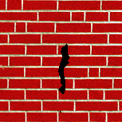
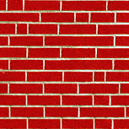
Hole Filling

Slide 12
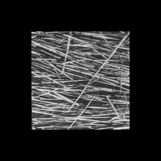
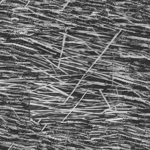
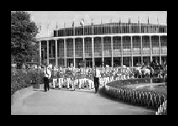
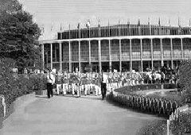
Extrapolation

Slide 13
Summary
The Efros & Leung algorithm
Very simple
Surprisingly good results
Synthesis is easier than analysis!
…but very slow

Slide 14
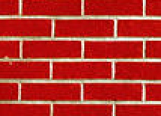
Image Quilting [Efros & Freeman]
non-parametric
sampling
p
B
Input image
Synthesizing a block
Observation: neighbor pixels are highly correlated
Idea: unit of synthesis = block
Exactly the same but now we want P(B|N(B))
Much faster: synthesize all pixels in a block at once
Not the same as multi-scale!

Slide 15
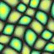
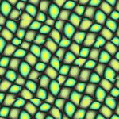
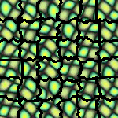
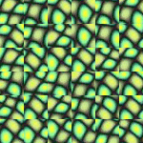
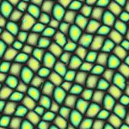
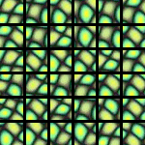
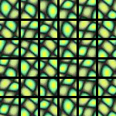
block
Input texture
B1
B2
B1
B2
B1
B2
Random placement
of blocks
Neighboring blocks
constrained by overlap
Minimal error
boundary cut

Slide 16
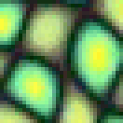
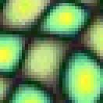
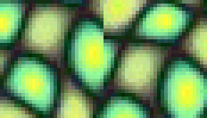

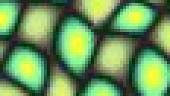

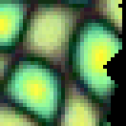

Minimal error boundary
overlapping blocks
vertical boundary
2
_
=
overlap error
min. error boundary

Slide 17
Philosophy!
The “Corrupt Professor’s Algorithm”:
Plagiarize as much of the source image as you can
Then try to cover up the evidence
Rationale:
Texture blocks are by definition correct samples of texture so problem only connecting them together

Slide 18





Slide 19





Slide 21





Slide 22



Slide 23






Slide 24
Failures
(Chernobyl
Harvest)

Slide 25





Portilla & Simoncelli
Xu, Guo & Shum
input image
Wei & Levoy
Our algorithm

Slide 26





Portilla & Simoncelli
Xu, Guo & Shum
input image
Wei & Levoy
Our algorithm

Slide 27





Portilla & Simoncelli
Xu, Guo & Shum
input image
Wei & Levoy
Our algorithm

Slide 28

Political Texture Synthesis!

Slide 29
Convnet for texture synthesis?
Of course!
https://arxiv.org/abs/1505.07376
More recently: http://vcc.tech/research/2018/TexSyn
Dynamic texture: https://ryersonvisionlab.github.io/two-stream-projpage/

